Slide 1
Project Definition & Tips for Working with Mango EE418 Senior Design, Fall 2015
Daqing Hou

Slide 2
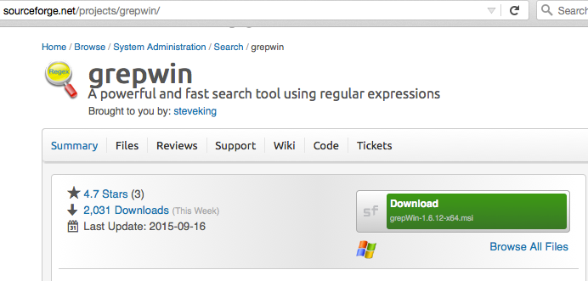
Grep for Windows
Notes:
Greg Werbowsky <werbowgz@clarkson.edu>

Slide 3
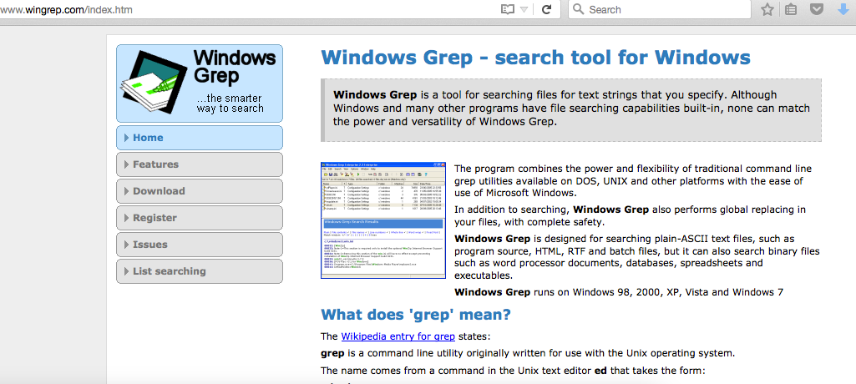

Slide 4
Git Bash

Slide 5
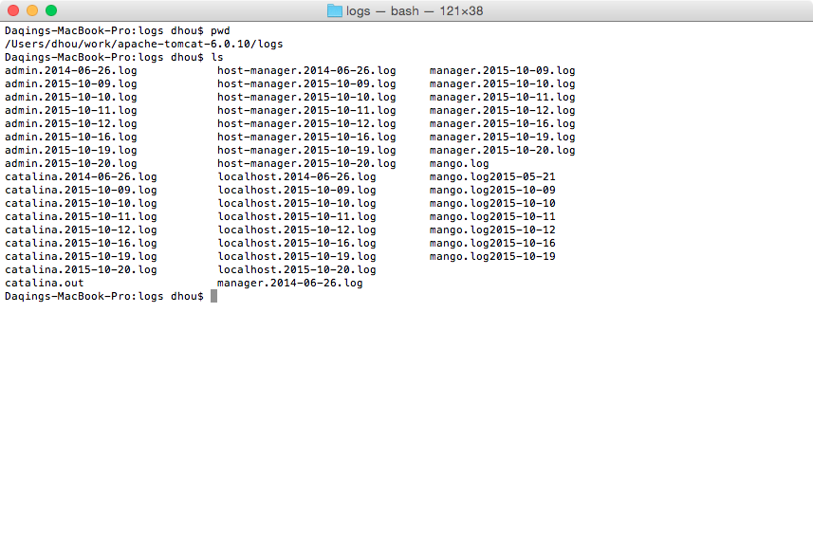
Leveraging Mango’s Logs

Slide 6
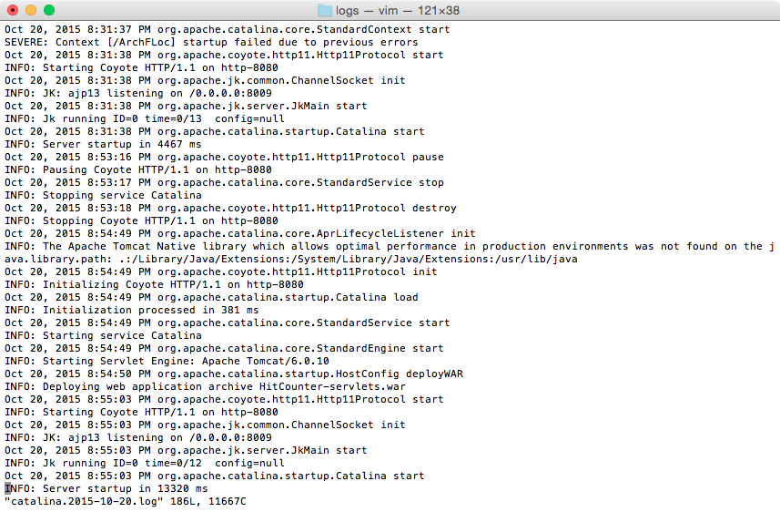
catalina.yyyy-mm-dd.log: info about Tomcat initialization

Slide 7
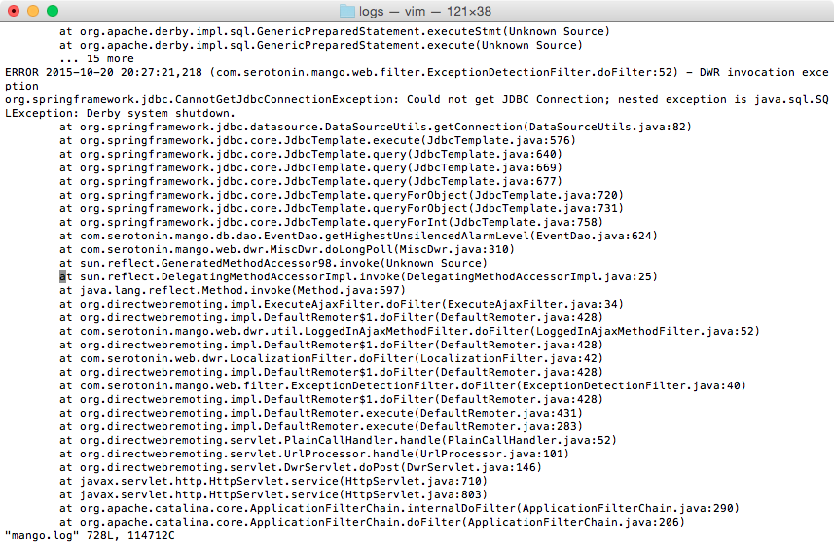
mango.log: runtime info about web apps

Slide 8
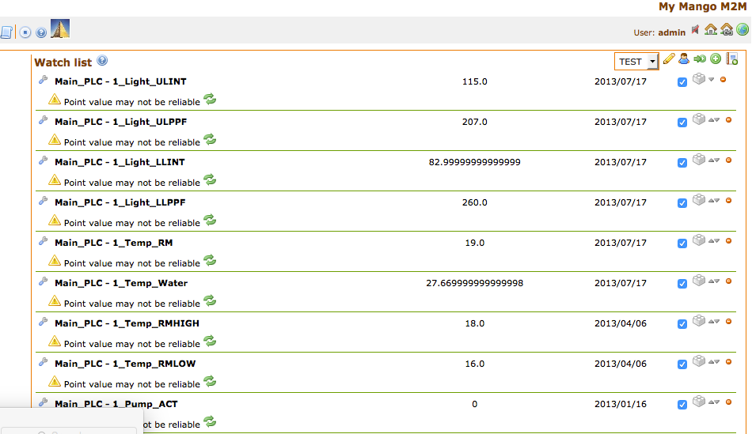
FR1: Change Precision of Displayed Numerical Values to 2 decimal digits

Slide 9
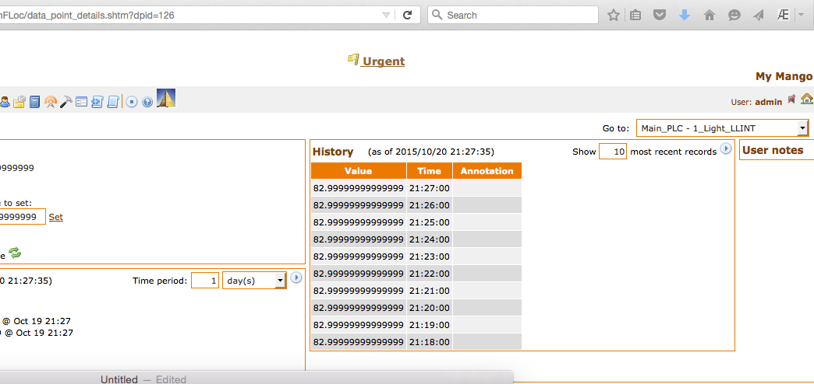
Need to find out all VIEWS that display numerical values

Slide 10
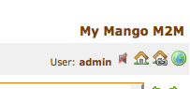
FR2: Muted Speaker by Default

Slide 11
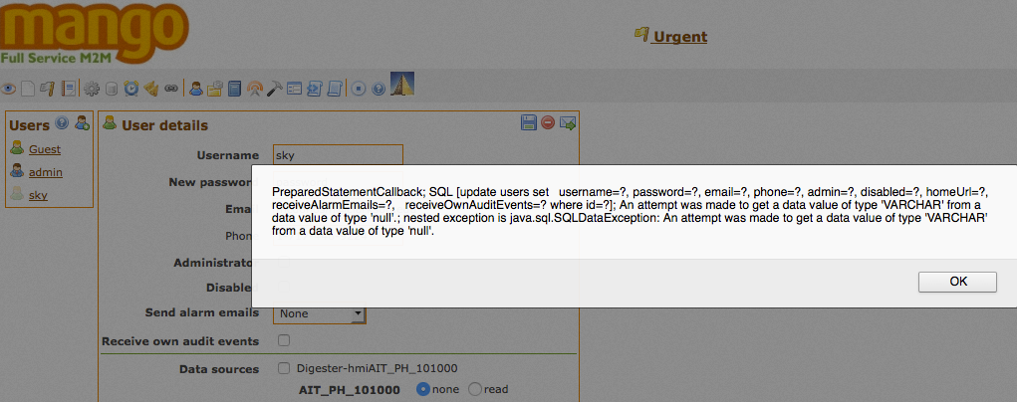
FR3: Fix bug in changing password

Slide 12
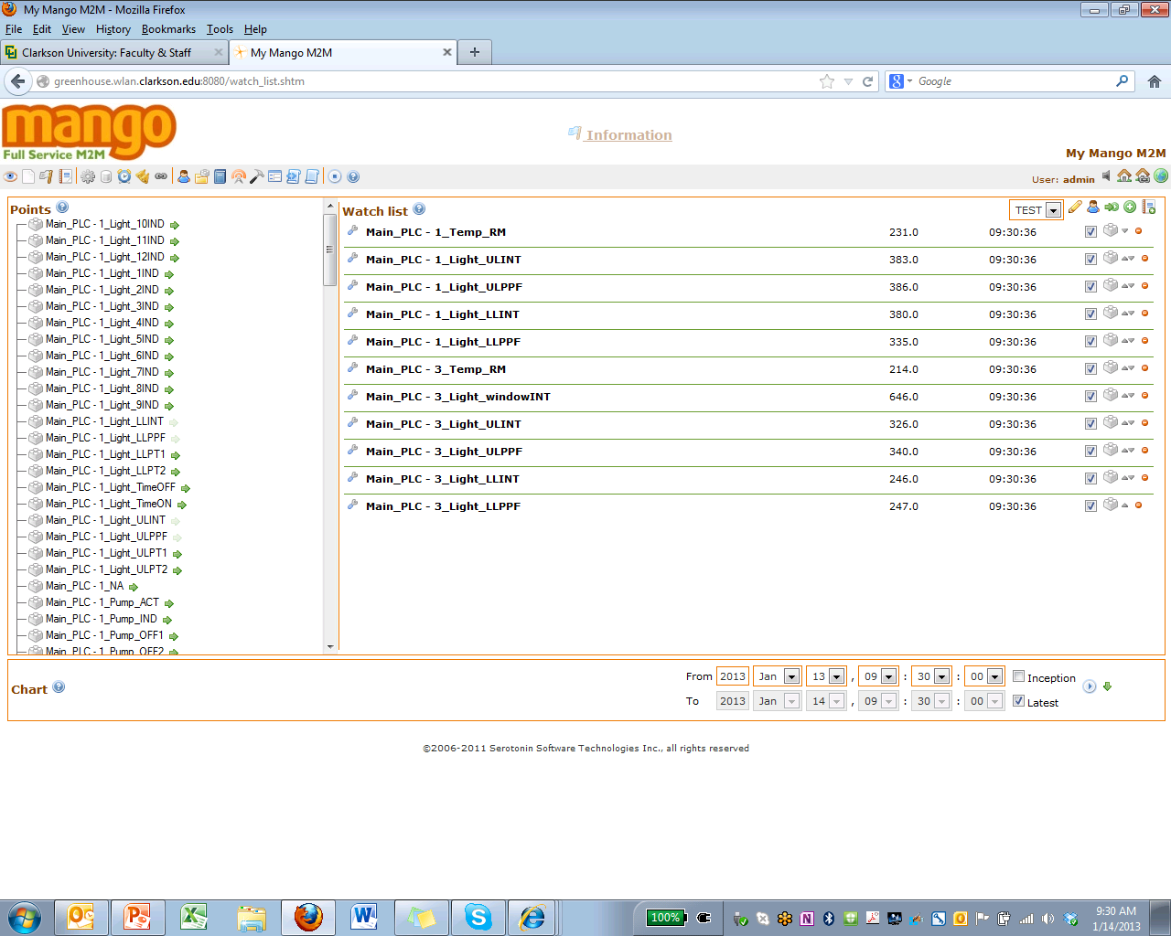
FR4: Change the initial view from watchlist to a new view of your design

Slide 13
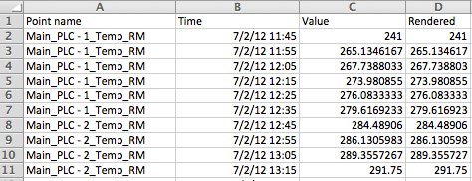
FR5: Excel files format: from vertical

Slide 14
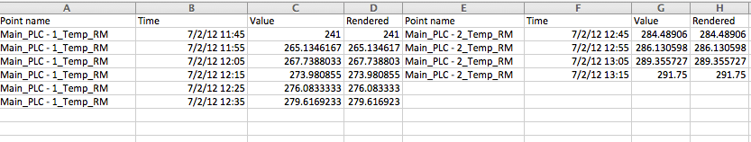
Excel files format: to horizontal

Slide 15
FR6: Choose one feature below
Optimize performance of run reports
Currently very slow
Need to improve database design
Add new charts to reports
Only plain line graphs, need reference lines and ability to add descriptive labels for X and Y axes
Need scatterplots

Slide 16



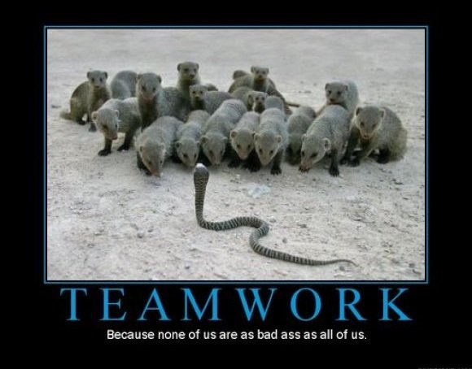
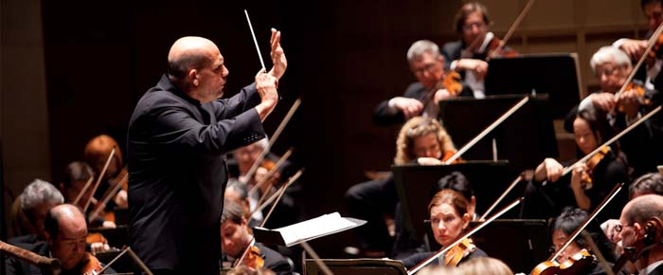
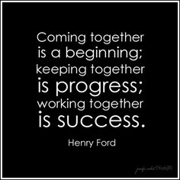

This is what you call team ….

Slide 17

This is what you call team ….

Slide 18
Team Role Assignment
In this senior design project, everyone is required to rotate through the following 4 roles:
Requirement Engineer
Figures out customer requirements (What needs to be done?)
Performs initial analysis and design
Document them
Developer: Design solution, write/document code
Tester: Have we done it right? Writes test cases and performs testing
Team Lead: Coordinate teamwork
What is status of task? On schedule?
Negotiate with customers (that is ME)

Slide 19
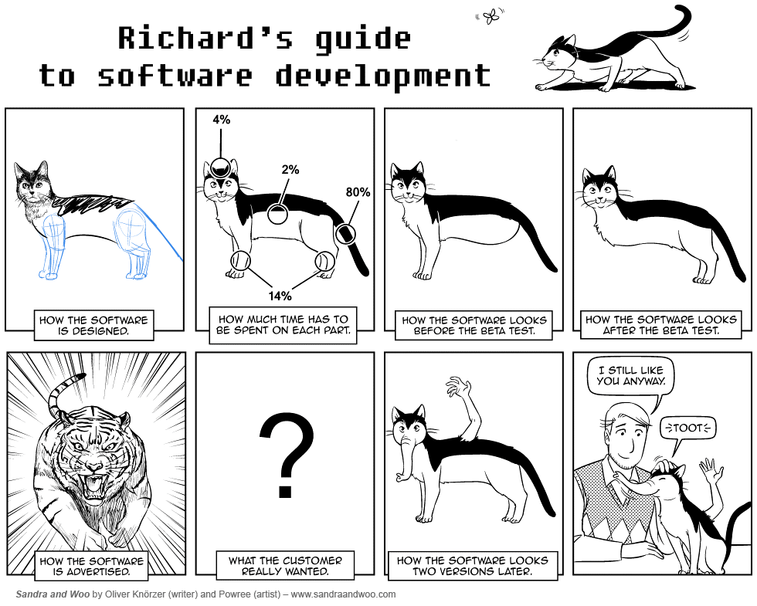

Slide 20
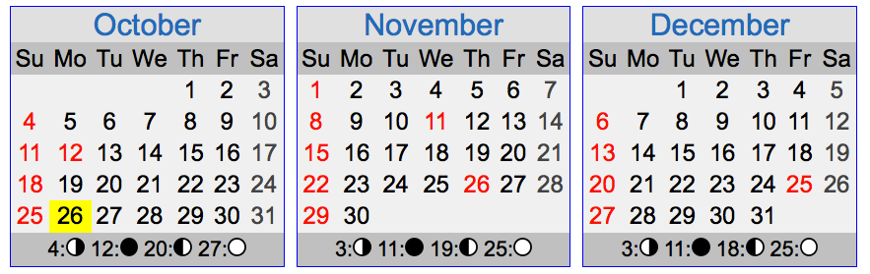
Schedule
Week 1 (10/26-10/30): FR1, FR2 (4%+4%)
Week 2 (11/2-11/6): FR3, FR4 (5%+5%)
Week 3 (11/9-11/13): FR5 (10%)
Week 4 (11/16-10/20): FR6 (10%)
Week 5 (11/23, 12/1-12/4): Final report (5%+lessons learned 2%) and presentation (5%)
For each feature, deliver documentation, including
Team roles
Requirements description
Design description (what you have added/modified and why)
Demonstration screenshots

Slide 21
Get to work, now!
Download and install latest Mango source code and MangoDB from gitlab
Name your team and build a code repository in gitlab for your team. Use it!
Short introduction to ArchFLoc

Slide 22
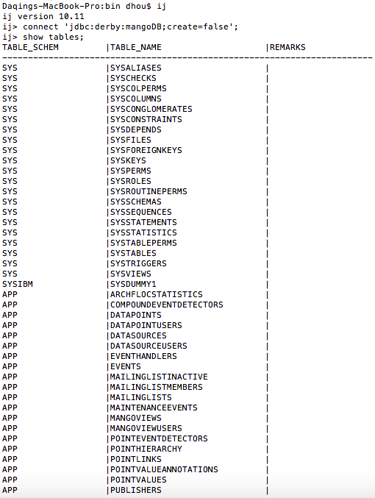
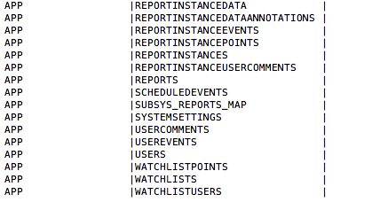
FR6: Database optimization

Slide 23
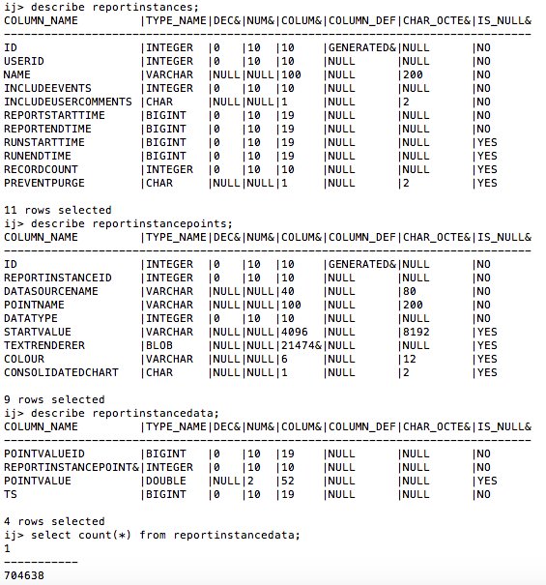

Slide 24
